Slide 1


Machine Intelligence
VC Dimension
Dr. Arti Arya
Department of Computer Science
artiarya@pes.edu
+080-66186629 Extn 6629

Slide 2
MACHINE INTELLIGENCE
VC Dimension
Dr. Arti Arya
Department of Computer Science and Engineering

Slide 3
Computational Learning Theory
Entire subfield devoted to the mathematical analysis of machine learning algorithms
Has led to several practical methods:
PAC (probably approximately correct) learning -→ boosting
VC ( Vapnik- Chervonenkis) theory -→ support vector machines

Slide 4
Computational Learning Theory
Fundamental Question: What general laws constrain inductive learning?
Seeks theory to relate:
Probability of successful learning
Number of training examples
Complexity of hypothesis space
Accuracy to which target function is approximated
Manne in which training examples should be presented

Slide 5
Sample Complexity
Assume that f : X → {0,1} is the target concept
How many training examples are sufficient to learn the target concept f?
If learner proposed instances as queries to teacher
Learner proposes instance x, teacher provides f(x)
2. If teacher (who knows f) provides training examples
Teacher provides labelled examples in form <x, f(x)>
3. If some random process (e.g., nature) proposes instances
Instance x generated randomly, teacher provides f(x)

Slide 6
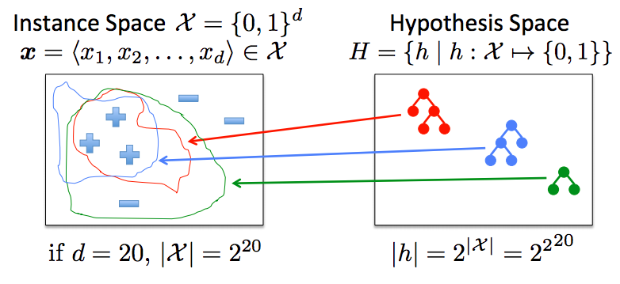
Function Approximation: The Big Picture
How many labeled instances are needed to determine which of the 2²⁰ hypothesis are correct?
All 2²⁰ instances in X must be labeled!
Generalizing beyond the training data (inductive inference) is impossible unless we add more assumptions (e.g., priors over H)
There is no free lunch!

Slide 7
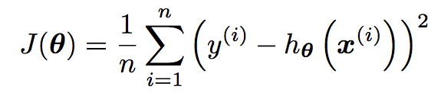

Bias Variance Decomposition of Squared Error
Assume that y = f(x) + ∈
Noise ∈ is sampled from a normal distribution with 0 mean and variance σ² : ∈ ∼ N(0, σ² )
Noise lower-bounds the performance we can achieve
Recall the following objective function:
We can re-write this as the expected value of the squared error:

Slide 8
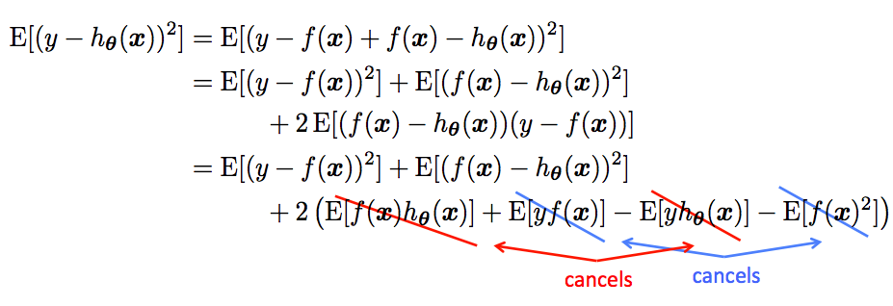

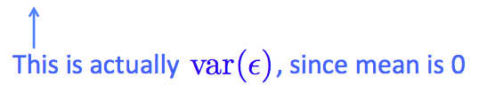
Bias Variance Decomposition of Squared Error
Therefore,

Slide 9
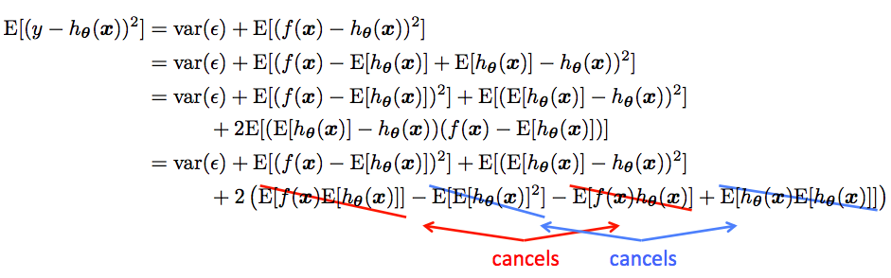
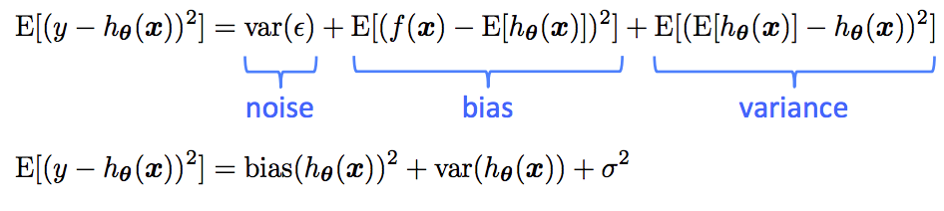
Bias Variance Decomposition of Squared Error
Therefore,

Slide 10
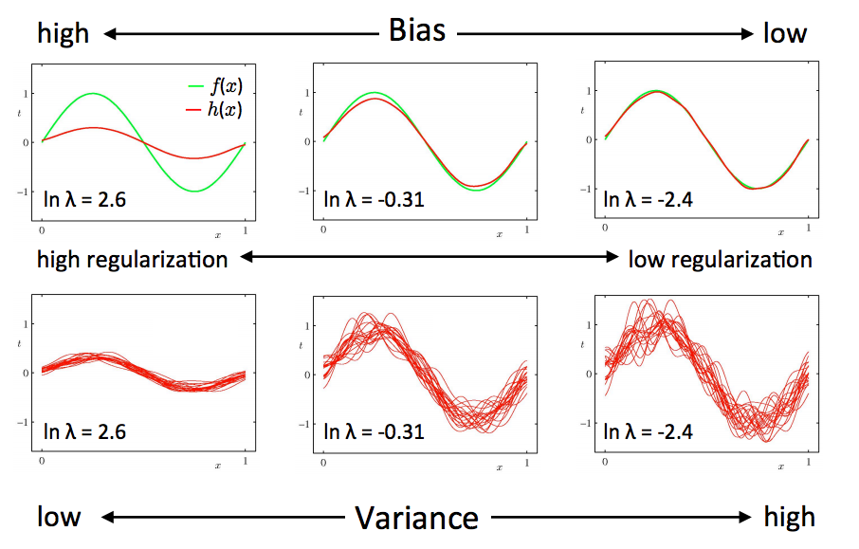
Illustration of Bias-Variance

Slide 11
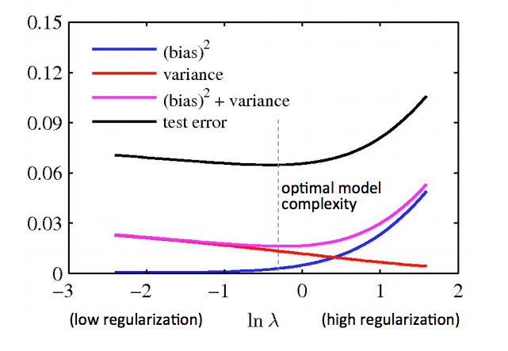
Illustration of Bias-Variance
Training error drives down bias, but ignores variance

Slide 12

A way to choose the Best Model
It would be really helpful if we could get a guarantee of the following form:
testingError <= trainingError + f (n,h,p)
n= size of training set
h= measure of the model complexity
p= the probability that this bound fails
Then, we could choose the model complexity that minimizes the bound on the test error

Slide 13
A measure of Model Complexity
Suppose that we pick n data points and assign labels of + or – to them at random
If our model class (e.g., a decision tree, polynomial regression of a particular degree, etc.) can learn any association of labels with data, it is too powerful!
More power: can model more complex functions , but may overfit
Less power: won’t overfit, but limited in what it can represent
Idea: characterize the power of a model class by asking how many data points it can learn perfectly for all possible assignments of labels
This number of data points is called the Vapnik-Chervonenkis (VC) dimension

Slide 14
VC Dimension
A measure of the power of a particular class of models
It does not depend on the choice of training set
The VC dimension of a model class is the maximum number of points that can be arranged so that the class of models can shatter
Definition: a model class can shatter a set of points
x⁽¹⁾, x⁽²⁾, ….., x^{(r)}
if for every possible labeling over those points, there exists a model in that class that obtains zero training error

Slide 15
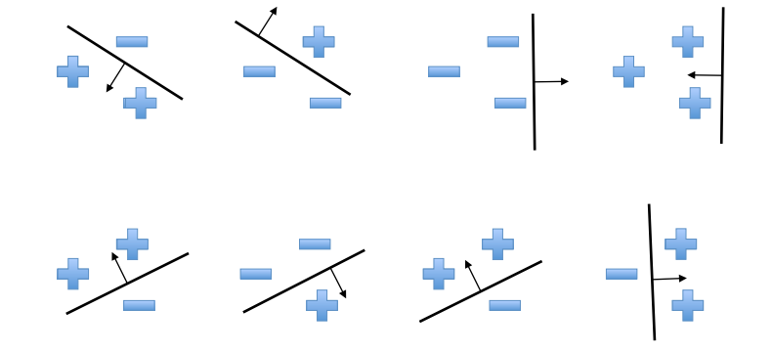
An Example of VC Dimension
Suppose our model class is a hyperplane
Consider all labeling over three points in R²
In R², we can find a plane (i.e., a line) to capture any labeling of 3 points. A 2D hyperplane shatters 3 points

Slide 16
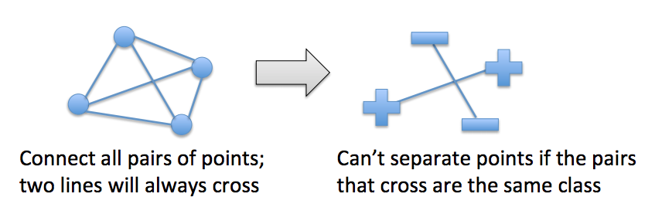
An Example of VC Dimension
But a 2D hyperplane cannot deal with some labelings of four points:
Therefore, a 2D hyperplane cannot shatter 4 points

Slide 17
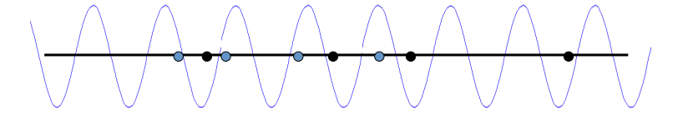
Some examples of VC Dimension
The VC dimension of a hyperplane in 2D is 3.
In d dimensions it is d + 1
It is just a coincidence that the VC dimension of a hyperplane is almost identical to the #parameters needed to define a hyperplane
A sine wave has infinite VC dimension and only 2 parameters!
By choosing the phase & period carefully, we can shatter any random set of 1D data points (except for nasty special cases)
h(x) = a sin (bx)

Slide 18
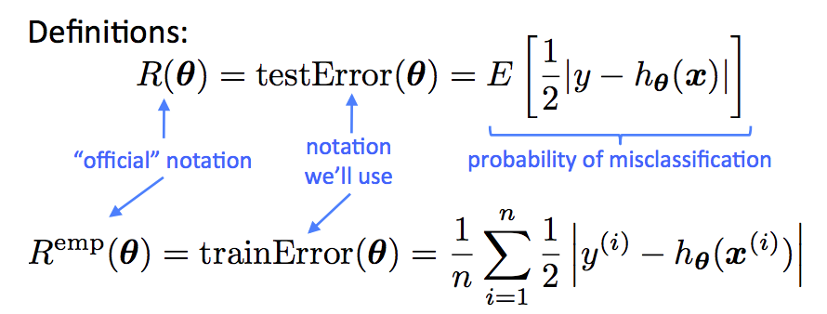
Assumptions
Given some model class (which defines the hypothesis space H)
Assume all training points were drawn from distribution D
Assume all future test points will be drawn from D

Slide 19
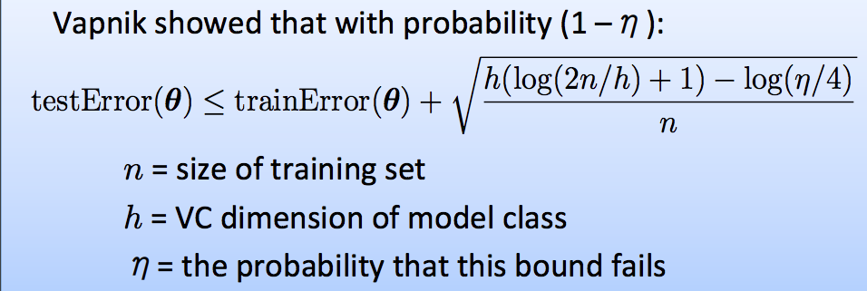
A Probabilistic Guarantee of Generalization Performance
So, we should pick the model with the complexity that minimizes this bound
Actually, this is only sensible if we think the bound is fairly tight, which it usually isn’t
The theory provides insight, but in practice we still need some magic

Slide 20
Take Away Lesson
Suppose, we find a model with a low training error….
If hypothesis space H is very big (relative to the size of the training data n), then we most likely got lucky
If the following holds:
H is sufficiently constrained in size
and/or the size of the training data set n is large,
then low training error is likely to be evidence of low generalization error

Slide 21
THANK YOU
Dr. Arti Arya
Department of Computer Science
artiarya@pes.edu
+91 9972032451 Extn 029

